Slide 1

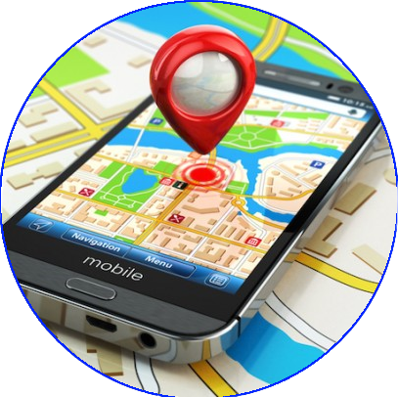
Employee Tracking mobile app
PRESENTING BY :
RIYA GUPTA [2000970100085]
SHASHANK SRIVASTAVA [2000970100100]

Slide 2
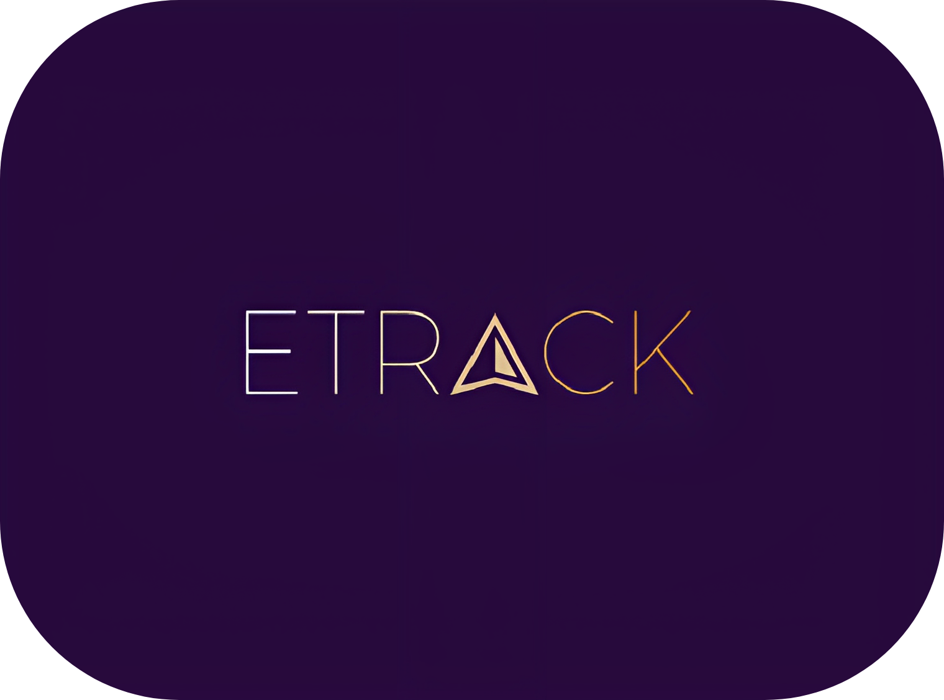
E-TRACK
E-TRACK is a software application that enables admin to monitor the attendance, performance, and productivity of their employees.
The app provides real-time tracking of employee activities, such as clocking in and out in an organization .
Overall, E-TRACK helps employers to optimize their workforce management, enhance productivity, and improve employee engagement.
The app provides real-time tracking of employee activities, such as clocking in and out, task assignments, and progress updates

Slide 3
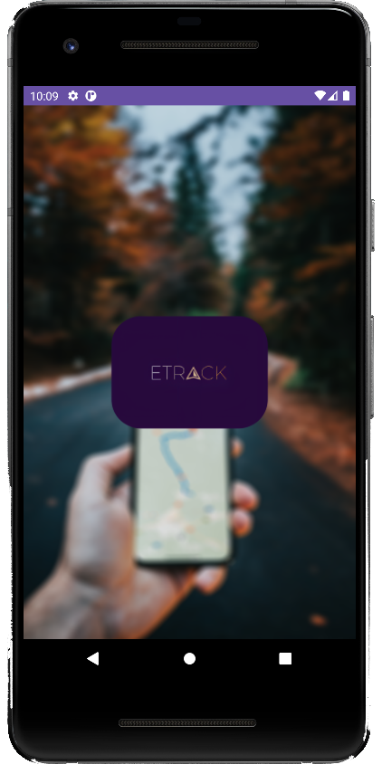




E-TRACK Features
GPS features
Track employees on real time
Basis & know their live movements on Google map
Update location
E-TRACK update the location of employee in every 5 sec for 100%accuracy.
100% assurance
Get assured about your employee’s status by ensuring they are safe and productive .
Task provide
This app will allow the admin to provide
the task to employee ,and the employee will able to check and perform those task immediately.

Slide 4
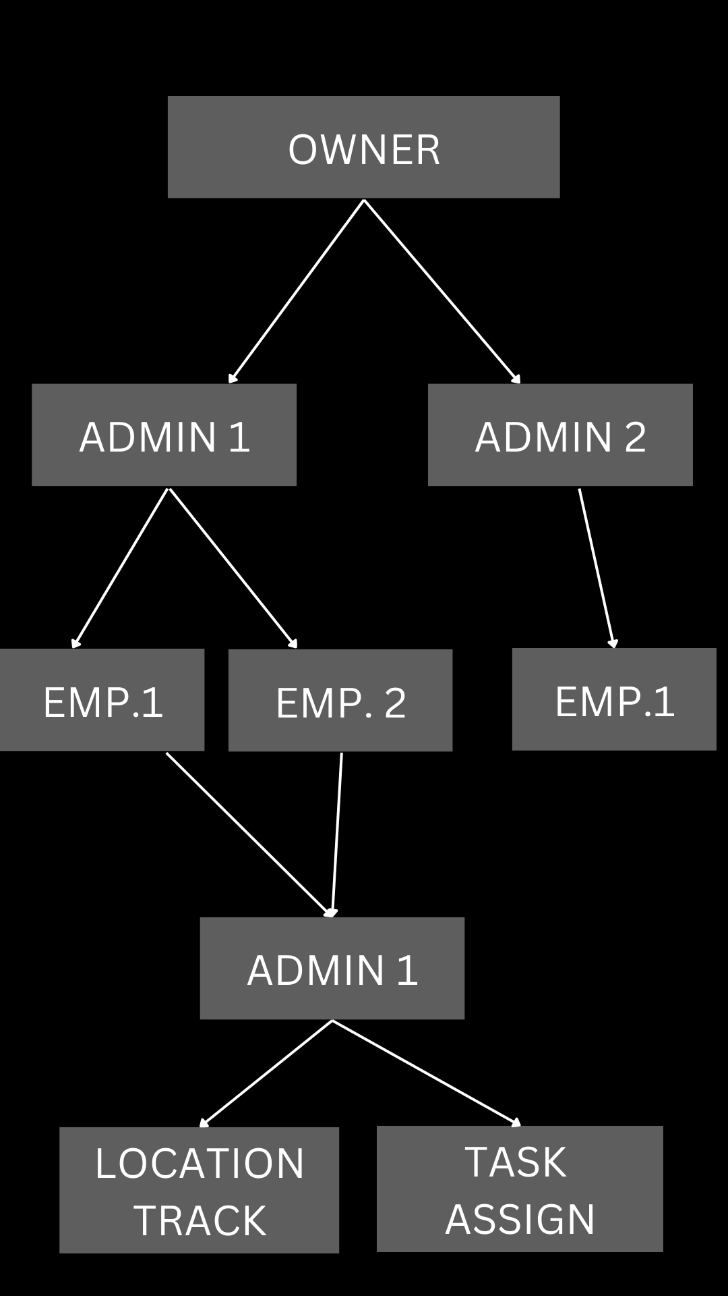
APP ARCHITECTURE

Slide 5
App Interface.

Slide 6
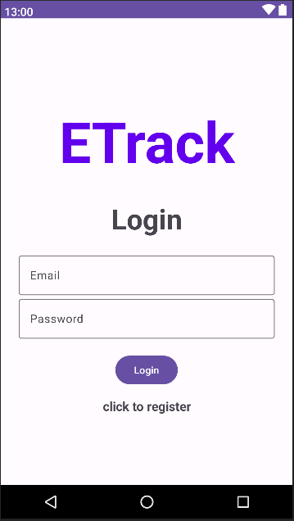
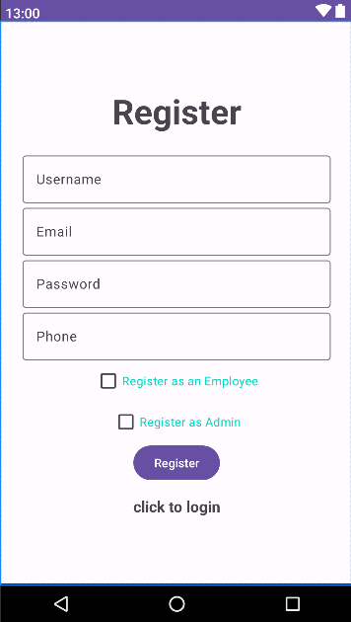
Authentication
Login Screen
Registration Screen

Slide 7
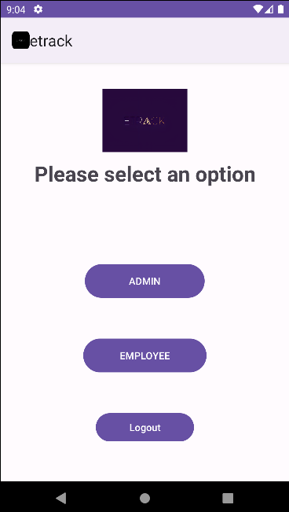
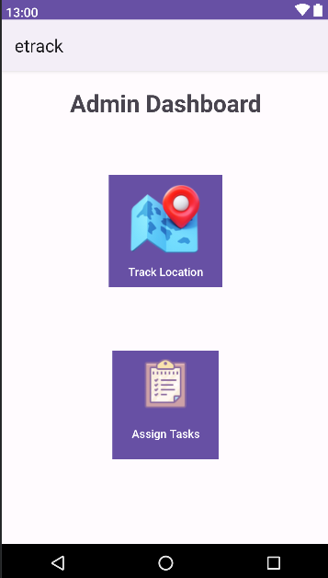
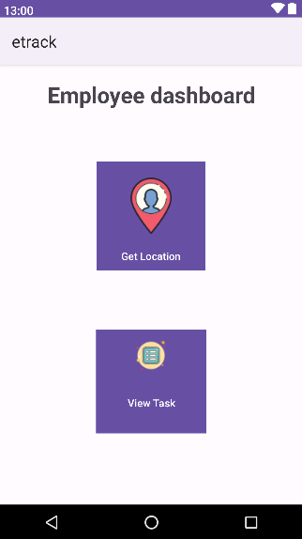
User dashboard
Employee dashboard
Admin dashboard

Slide 8
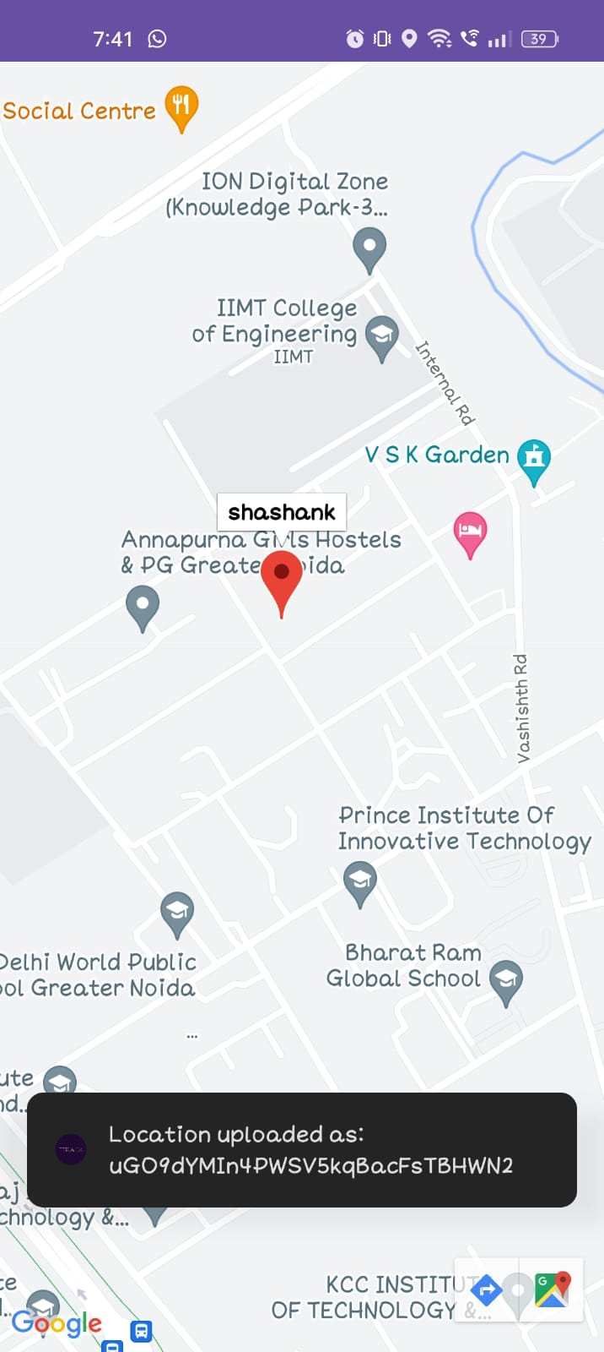
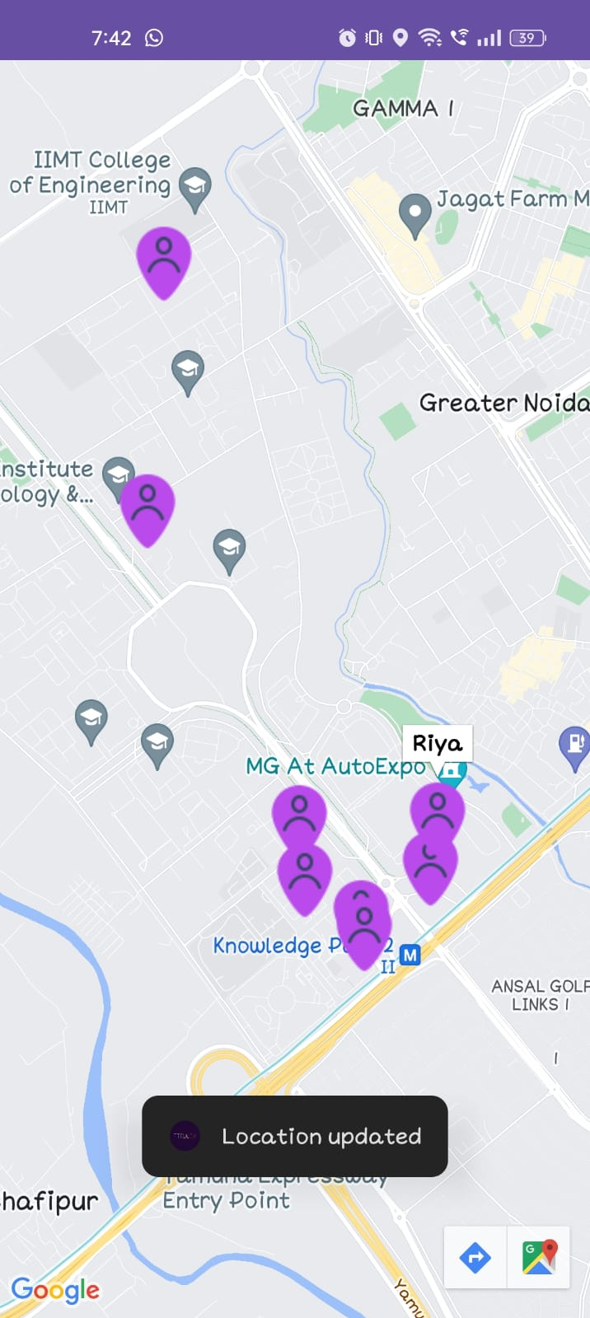
LOCATION TRACKING
Own Location
All Employee Location

Slide 9
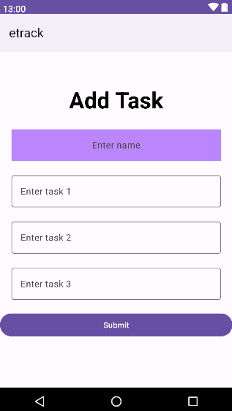
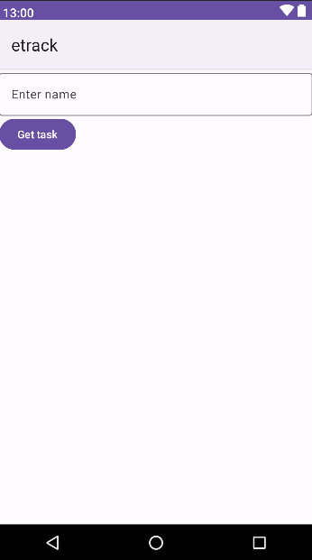
TASK
ASSIGNMENT

Slide 10




Data Model
DATA FLOW
android

Slide 11




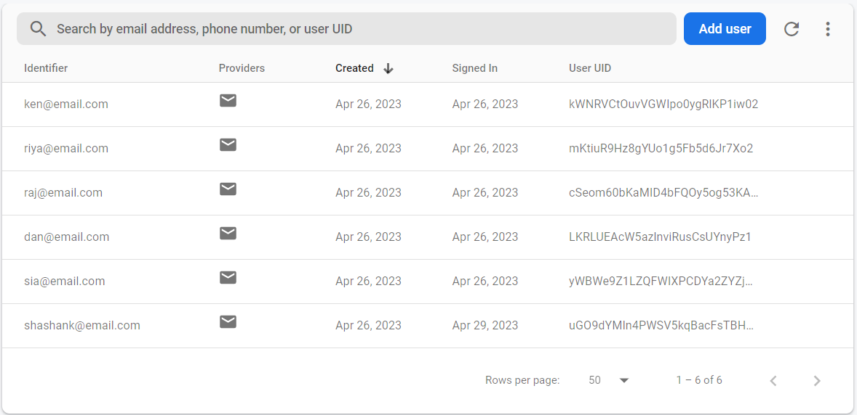
AT THE TIME OF LOGIN/REGISTRATION
LOGIN/REGISTRATION DATA
FIREBASE CONSOLE

Slide 12
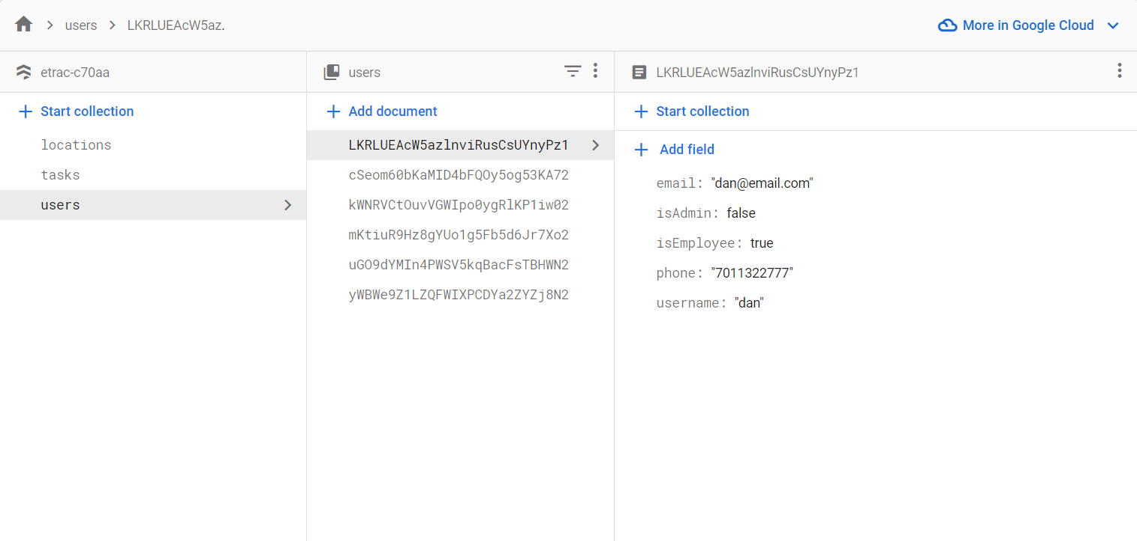
ONCE USER IS CREATED IT’S DATA IS STORED UNDER DATABASE
Firestore uses a NoSQL document-oriented database structure to store data. Data is stored as collections of documents, where each document contains a set of key-value pairs. The values can be of different data types such as strings, numbers, arrays, or even nested objects. Documents are then organized into collections, which are similar to tables in a relational database.

Slide 13
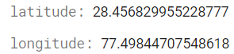
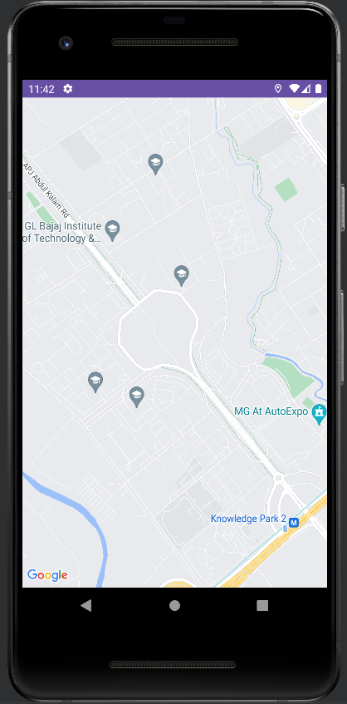
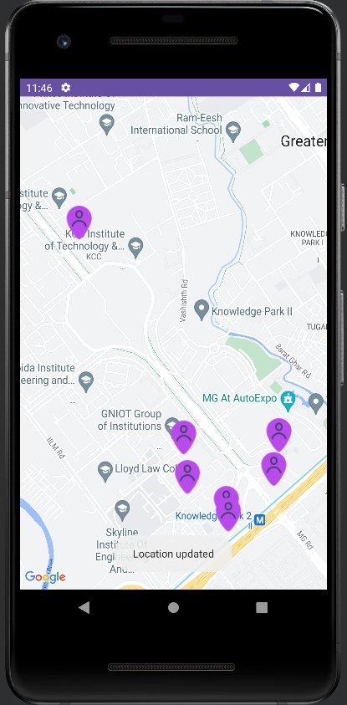
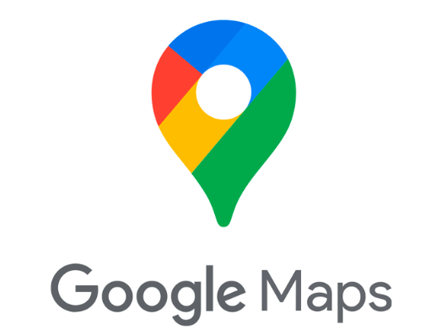

FETCHING LOCATION
android

Slide 14
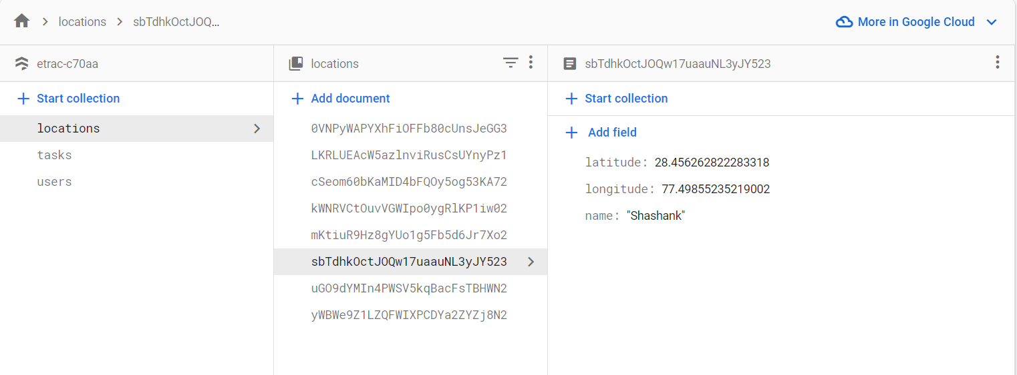
DATABASE STORING THE LOCATION DATA
Google provides a Location API that allows developers to retrieve a user's current location. This API can be used in combination with Firebase and Android Studio to store and retrieve location data in real-time.
GPS: The API uses GPS to get the user's exact location. This is the most accurate method, but it requires the user to have a GPS-enabled device and be in an area with clear line-of-sight to GPS satellites.
The location is Updated at the interval of every 3 seconds. Hence it show the most recent location of the User.

Slide 15
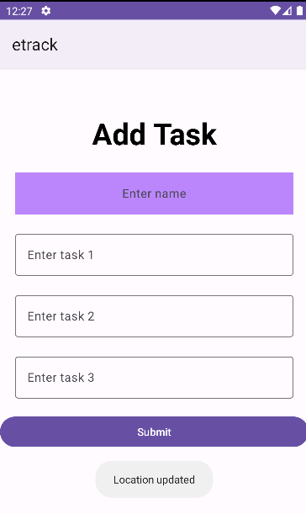
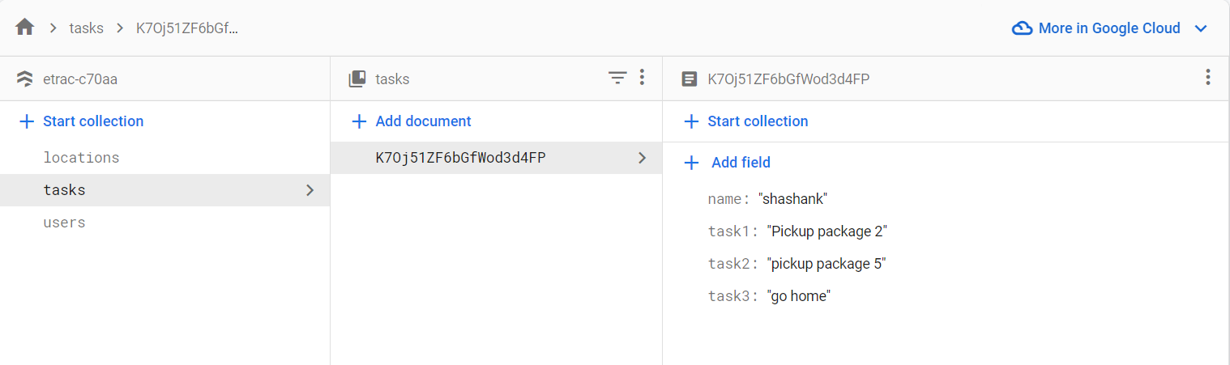
ASSIGNING TASKS
As a admin we can assign task to the employees, these tasks are stored on the data based under the title tasks. Which is then used to retrieve the tasks and show it on the employee panel.

Slide 16
SECURITY
One of the main security features in our app is the Firebase Authentication service, which allows you to easily authenticate users with a variety of different providers such as Google, Facebook, and email/password. This ensures that only authorized users can access your app's data and features.
It uses Transport Layer Security (TLS) to encrypt all data in transit between your app and Firebase servers. This helps prevent data interception and ensures the privacy and integrity of your data.
App provides several monitoring and logging features that allow you to track and analyze access to app's resources, detect potential security issues, and quickly respond to any security incidents.

Slide 17
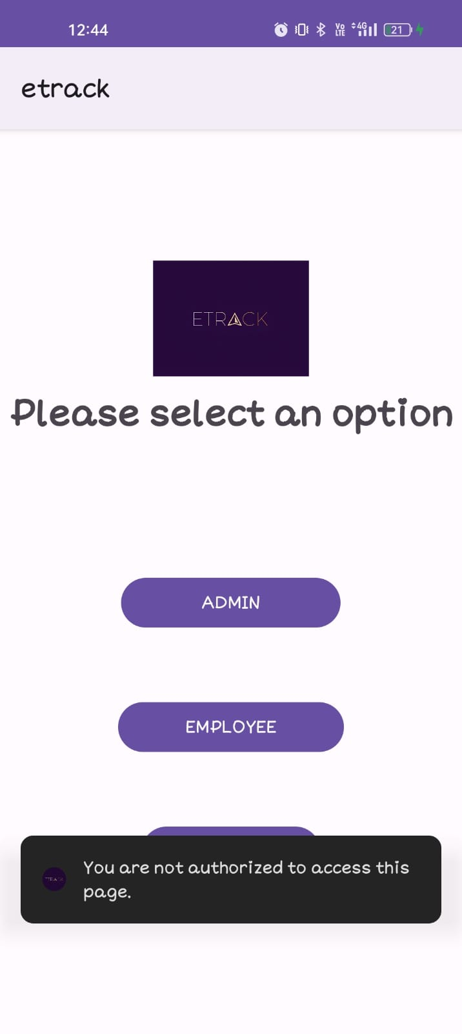
Also at the app level users are differentiated on the basis of their roles.
A admin has superior access to the data inside the app.
Only the users with admin roles can track the locations of other users.
If you are an employee, an access denied message would be prompt on the screen if you try to enter the admin panel.
Hence no employee can get a third party access to everyone's location.

Slide 18
THANK YOU

